Slide 1

Locating right neighbourhood for opening a new warehouse
(Data Capstone Project)
Dipesh narang

Slide 2
Current challenges for Supplier XYZ
Background - Groceries supplier XYZ is one of the major supplier providing fresh and high-quality groceries to most of the food joints in Toronto, ON, Canada with its network of warehouses and Transportation fleet.
Current Challenge of Supply Chain in Etobicoke- In recent times , due to increase demand of groceries in Etobicoke, there has been an additional stress on the existing supply chain of XYZ. This increased demand is due to increase in population residing or migrated to Etobicoke due to increased economic activities and hence further potential of new food joints which will be coming up.
This has impacted the existing supplies in terms of on time and quality of delivery especially perishable groceries and high transportation cost.

Slide 3
Problem Description
Considering this scenario with increased demand of groceries, XYZ has decided to open new warehouse at optimal location in Etobicoke to resolve current supply chain challenges. The supplier plan to build new warehouse which shall be closest to its customers in order to minimize the cost of transportation for a foreseeable future to cater to increased demand.
.

Slide 4
Data we need
Geo-locational information of Etobicoke with its corresponding neighbourhoods and its postal codes from https://en.wikipedia.org/wiki/List_of_postal_codes_of_Canada:_M
Food joints and their location leveraging APIs from "Foursquare" locational information with basic information about all venue especially all the food joints in Etobicoke with respective neighbourhood. https://api.foursquare.com/v2/venues/explore?&client_id={}&client_secret={}&v={}&ll={},{}&limit={}'.format(
Demographics data including population density, change in population as per the last census and average income from wiki link: https://en.wikipedia.org/wiki/Demographics_of_Toronto_neighbourhoods
.

Slide 5
Methodology
Determining the warehouses’ locations can be seen as finding centroids of clusters of the corresponding served branches. Therefore, this is an excellent use case of K-means clustering. Using these data points of city centres, we can actually run the standard K-means clustering to solve the problem already. Yet, this approach would fail to take into account the fact that some cities are more densely populated and have higher average income group than others which implies having a higher volume demand for groceries to be supplied.
We have included the demographic data like population density, percentage change and average income population data for becoming proxy to groceries demands. This has been combined with city centres location and no of food joints data for clustering with k-means.
.

Slide 6
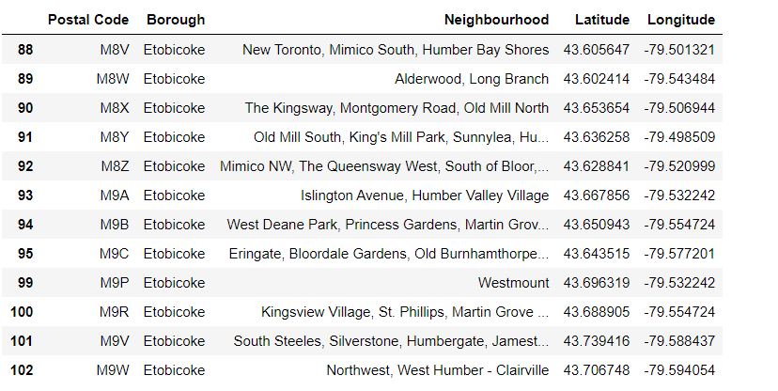
Methodology (Step 1)
Web scraping https://en.wikipedia.org/wiki/List_of_postal_codes_of_Canada:_M and cleaned and refined data for Etobicoke along with location details for its neighbourhood
.

Slide 7
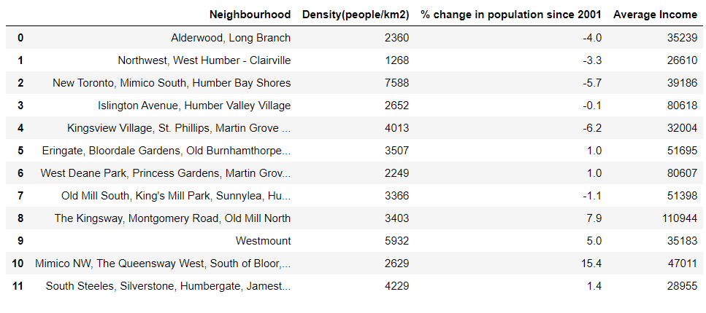
Methodology (Step 2)
Web scraping https://en.wikipedia.org/wiki/Demographics_of_Toronto_neighbourhoods and then cleanse and refine the data for Etobicoke to get population density, change in population as per the last census and average income.

Slide 8
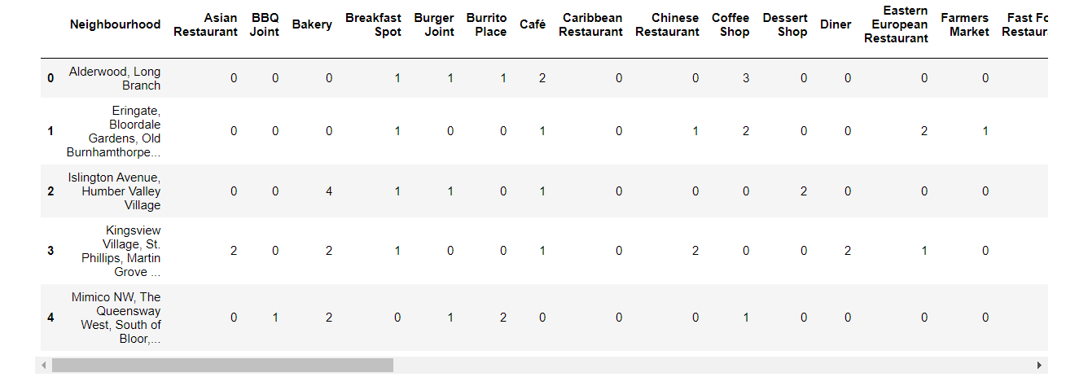
Methodology (Step 3)
Food joints and their location leveraging APIs from "Foursquare" locational information

Slide 9
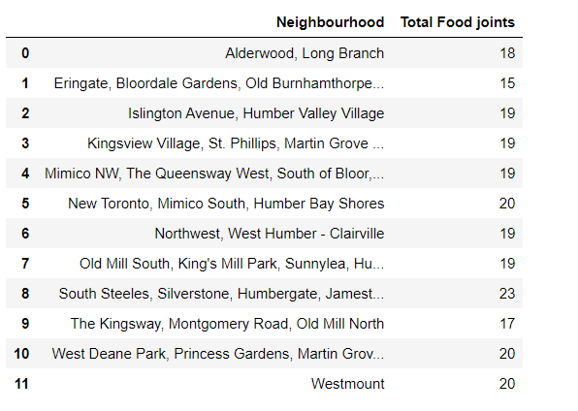
Methodology (Step 4)
After On-hot encoding we will integrate all restaurant columns to one column "Total Food Joints

Slide 10
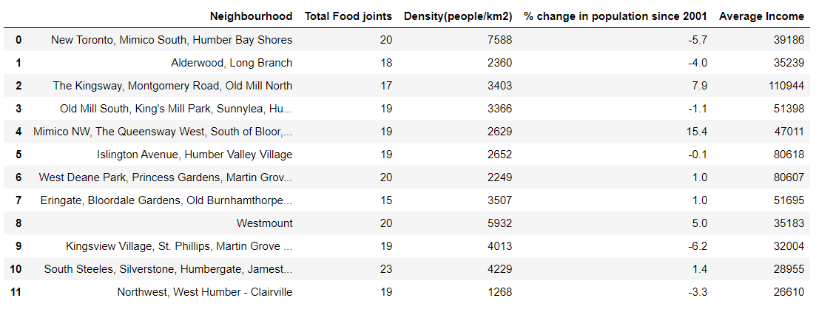
Methodology (Step 5)
Final dataset fully ready to be used for machine learning (and statistical analysis) purposes.
K-means clustering is then applied on this refined data set

Slide 11
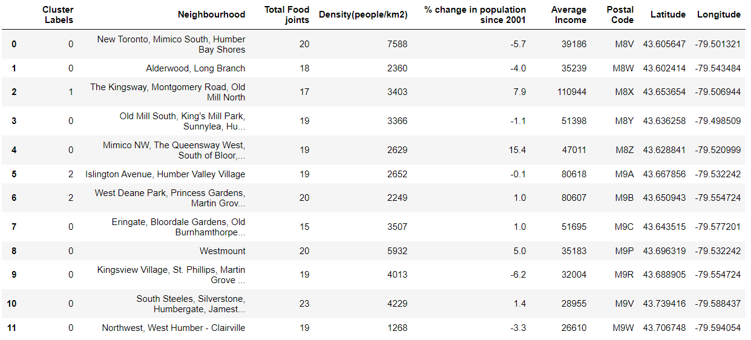
Results of k-means

Slide 12
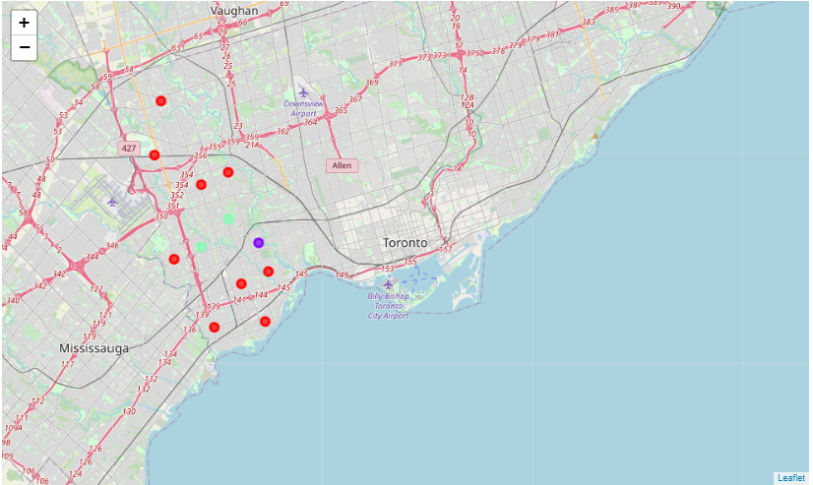
Results of k-means – cluster map
Cluster 0 (red marker) | This cluster has high population density with low population growth and low average income
Cluster 1 (blue marker) | This cluster has medium population density with high population growth and highest average income
Cluster 2 (green marker) | This cluster has low population density, low population growth and medium average income

Slide 13
Our Recommendation
We recommend that neighbourhoods corresponding to cluster 1 will be the best choice for the location of opening warehouse
Our recommendation is based on the following features of this cluster:
It has the highest average income as compared to other clusters and neighbourhood in the cluster has the highest average income
This cluster has the second highest cluster in terms of population growth. This hold the potential of further increased demand in near future.
Existing no. of restaurants are comparable to no. of restaurants in other clusters.
As per the cluster map, its quite evident that it is optimally located and almost a centre point for the entire Etobicoke area for the maximum coverage across other neighbourhoods.

Slide 14
Thanks you

